Slide 1
Usage Profile Update
OpenChain Japan Workgroup
2022/12/19

Slide 2
SPDX Mini Summit in Yokohama, December 8

Slide 3
Usage Profile Overview & Update
1.Sometimes, supplier side may designate “Usage” of Software Package on “Prerequisite Product” and/or intentions for specific configuration with the software package.
For example: “This software package must not conclude on final product. This is the software package just for VERIFICATION purpose”
2.Those intentions of “Usage” described on original contract between two companies supplier and consumer but does not reach downstream supply chain, in current real business.
There are those potential requirements exist for SBOM and SPDX from industrial scene
Will propose “Usage Profile” to describe those notification within SPDX
3.Open Chain Japan WG already contributed and accepted “Release Date”, “Build Date” and “Expiration Date” to Package Information descriptions.
Now preparing proposal to SPDX ver 3.0 as “Usage Profile”

Slide 4
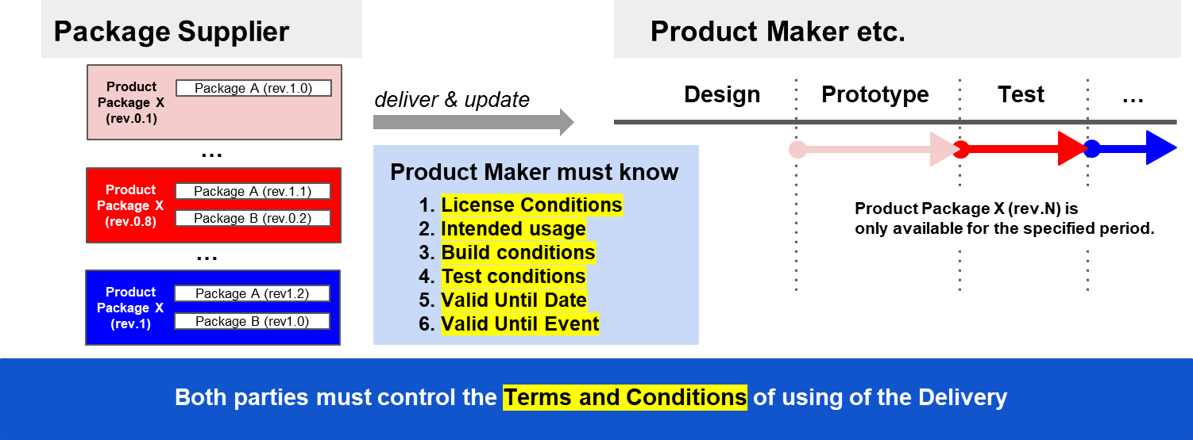
Usage Profile: to tell intentions as “Usage” for Delivery product

Slide 5
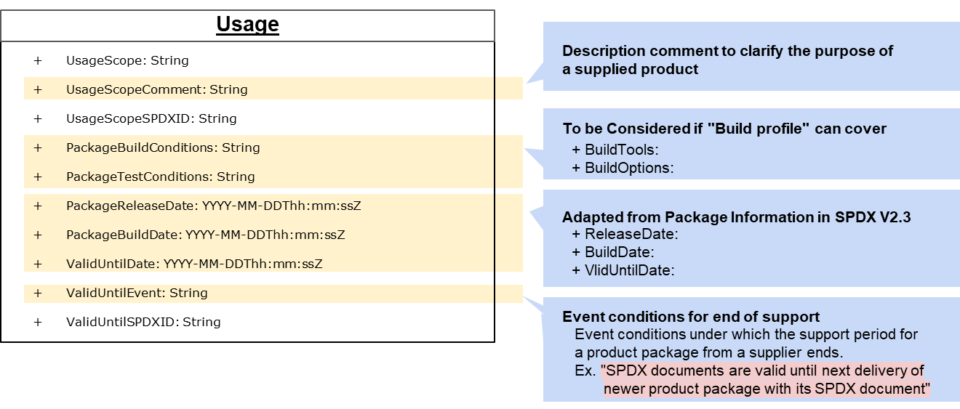
Data field which will be proposed as “Usage Profile”
Information on usage scope can be managed and operated in integrated manner with SBOM

Slide 6
Discussion
How handle build information in usage profile?
Can the command line information being proposed for build profile work?
Should we move this into the set of core properties?
Should build date, release date & valid until date properties be in core?
AI, Dataset, Usage, Build? Profiles are leveraging them.

Slide 7
OpenChain JWG Licensing sg December 19

Slide 8
from the SPDX mini summit discussion
The need for UsageProfile was understood by attendees.
Is the type “String” across the UsageProfile reasonable and consistent with other Profiles?
UsageProfile use cases should be discussed in more detail.
Each attribute should also be discussed in more detail.

Slide 9
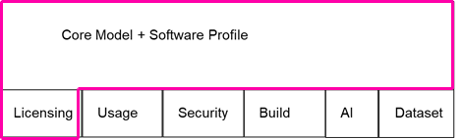
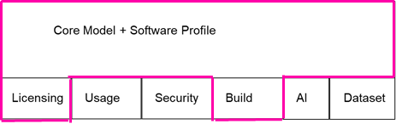
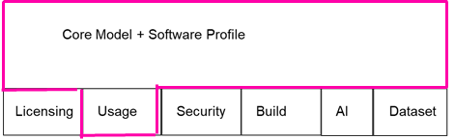
Use Case
When a supplier passes a deliverable (such as BSP) to a manufacturer, it may sometimes contain a specific OSS package for testing. Or may be built with special configuration.
Supplier
Deliverables - 1
SPDX for Distribution-1
lib-a
lib-b
This library is included in the distribution for testing purposes.
SPDX for lib-b
lib-a :
… (snip)
“UsageScope”: “for debugging X app with lib-a.so”,
“PackageBuildConditions”: {”CFLAGS”: “-DDEBUG –g”},
“ValidUntilDate”: “2023-01-01T00:00:00”,
“ValidUntilEvent”: “next RC(RC-2)”,
… (snip)
SPDX for lib-a
In these cases, manufacturers don't need detailed information about the build, but they need to know what CFLAGS are set up for testing.
And they need to know when it will be invalidated.

Slide 10
Discussion Result on December 19th.
should follow SLSA provenance
UsageProfile want to highlight options that will be removed in the future.

Slide 11
Thanks

Slide 12
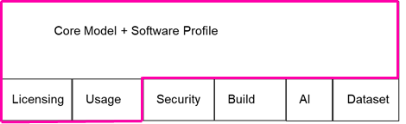
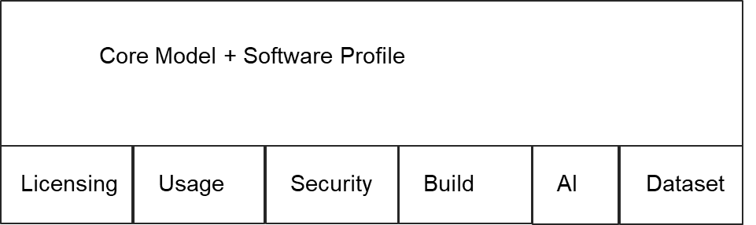
Use Case
SPDX for Distribution-1
Supplier
Distribution - 1
lib-a
lib-b
SPDX for lib-b
This library is included in the distribution for testing purposes.
SPDX for lib-a
lib-a :
“UsageScope”: “for debugging lib-a”,
“PackageBuildConditions”: {”CFLAGS”: “-DDEBUG –g”},
“ValidUntilDate”: “2023-01-01T00:00:00”,
“ValidUntilEvent”: “next RC(RC-2)”,

